Slide 1




Diving deep into the US Airline Industry
A Versatile Tableau Dashboard for Airline Industry Lovers
December 4th, 2019

Slide 2
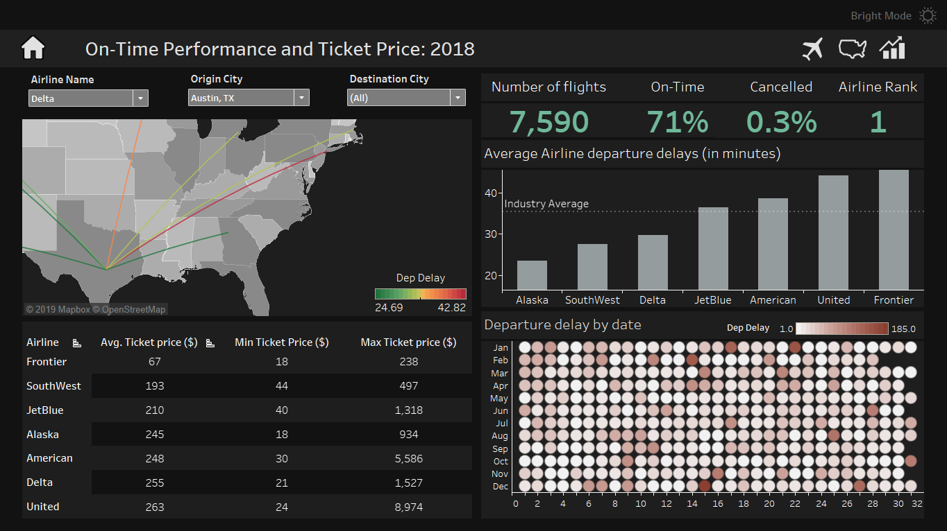
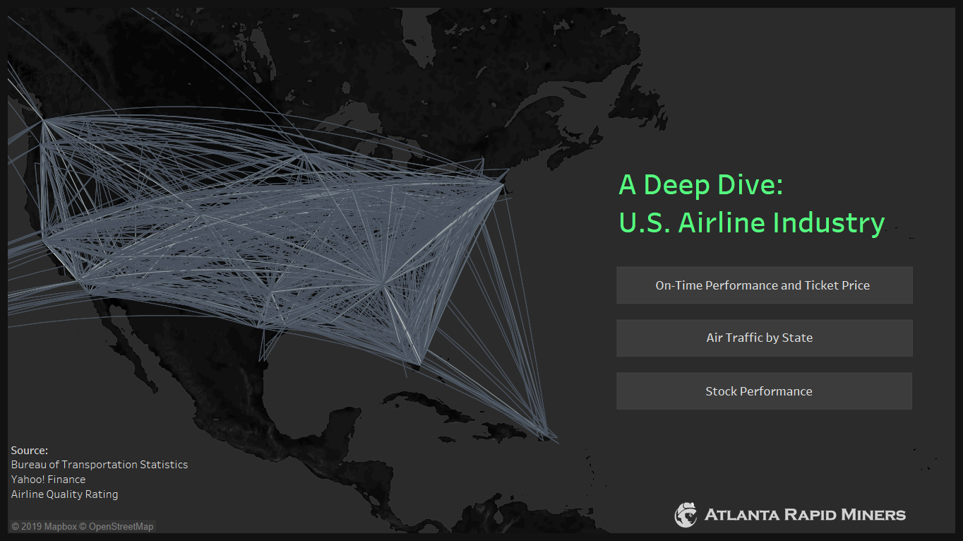
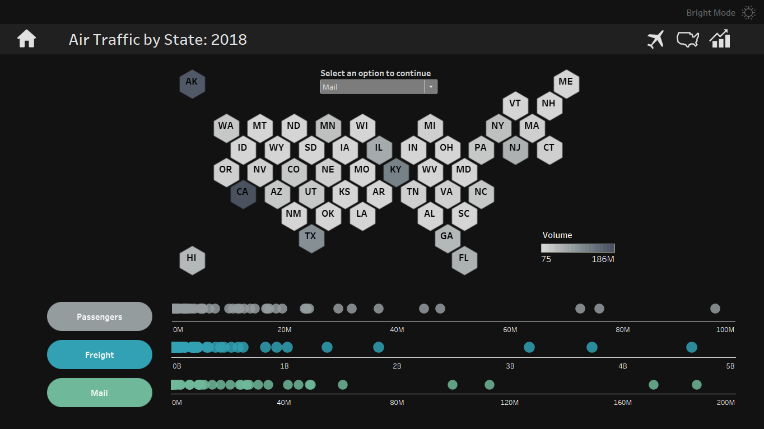
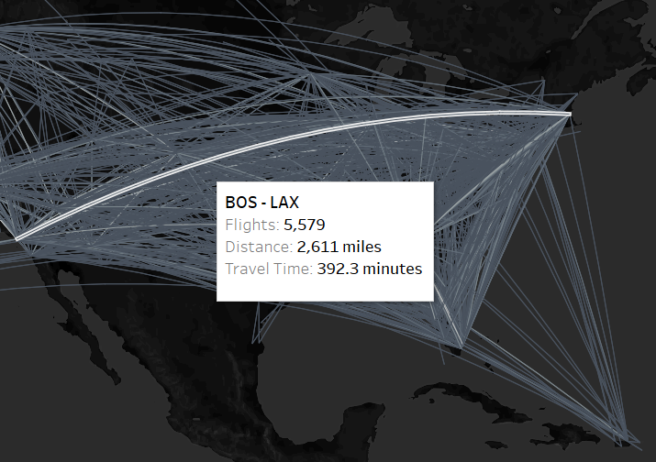
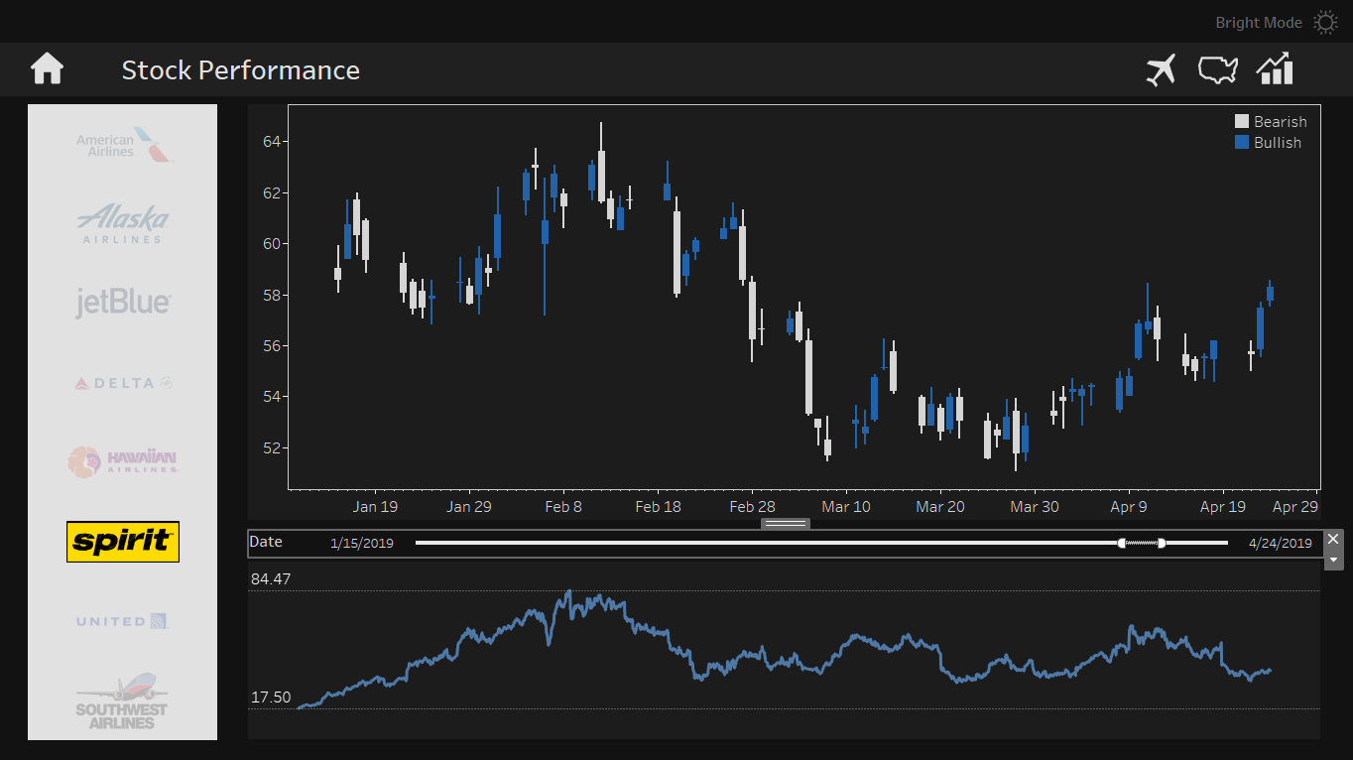
Demonstration
Dashboard Demonstration on Tableau
Notes:
Our Airline Industry Deep-Dive Dashboards are intended to answer some key questions and reveal hidden insights, such as
➔ make 3 different columns with dashboard name on top
Questions and sub-questions
Dashboard 1: Airline Traveler in the US by State
Which airlines dominates each states, in terms of their percentage share of overall depatures?
Which states have more travelers than the others
How much does each state contribute to the overall departures of Passengers, Freights, and mails relative to other States?
Dashboard 2: US Airline Domestic Performance Deep-Dive
How many flights does an airline operate between any route in the US?
What is the average On-time performance rate for that route?
What is the percentage cancellation rate for that route
Delay average (in minutes) comparison between airlines for each possible routes
Primary causes for departure delay
Delay time for each day in the calendar year 2018
Price range comparison between airlines for each route
Dashboard 3: Financial Performance of Each Airline
What is the stock price trend for each US airline in the past 5 years
Within each month, how much did the stock price of that airline vary? (shown using a candlestick graph)

Slide 3





Meet the Team
Barbara Wu
Patrick He
Harshit Arora
Jie Zhu

Slide 4
Project Overview
Inspiration: The ever so competitive nature of the $147 billions U.S. Airline Industry has made it very important for airlines to constantly monitor their performance as well as track their competitors
Frequent flyers are frustrated when they choose an airline that has performance issues. Airlines are frustrated when they are unable to uncover patterns and insights timely enough to fix performance gaps
Motivation: with winter break approaching, we want to ensure we book a flight that
a) Has a low cancellation/delay rate
b) Is well-reputed with a large customer base
c) Is priced well
The amount of rich- data available made it possible to capture the operations and performance of airlines from different angles
Some of us would love to work as Data Scientists at a major Airline
GOAL
Build an interactive Tableau dashboard which provides an “all you need to know interface” about the U.S. Airline industry, including the operational and financial performance for each airline company

Slide 5
Questions Raised
Our 3 dashboards are aimed to uncover insights by providing interactive visualizations that answer some key questions
Dashboard 1
Airline Travelers in the US by State
Which airlines dominates each states (in terms of their percentage share of overall departures)?
Dashboard 2
US Airline Domestic Performance Deep-Dive
How many flights does an airline operate between each unique route?
How much does each state contribute to the overall departures of Passengers, Freights, and mails relative to the rest?
What is the average On-time performance rate for that route?
What is the percentage cancellation rate for that route?
Primary causes for departure delay
Delay time for each day in the calendar year 2018
Price range difference between airlines for each route
Comparison between average delay (in minutes) different airlines for each possible route
Dashboard 3
Airline Stock prices
What is the stock price trend for each US airline in the past 5 years
Within each month, how much did the stock price of that airline vary? (shown using a candlestick graph)

Slide 6



Data Description
We leveraged flight level data and route level data to uncover numerous insights from 9 US airline operations
5+ million flights across 9 airlines
600+ routes across US
4+ GB data
200+ attributes
Location
Origin and Destination city
Airport latitudes, longitudes
State shape files
Financials
Airline stock prices (5+ years)
Ticket price by route
Flight Delays
Departure Delay rates
Cancellation rates
Causes for delay
The granularity of the data available made available by the Bureau of Transportation Statistics helps us provide an end-to-end monitoring system
Notes:
Our Airline Industry Deep-Dive Dashboards are intended to answer some key questions and reveal hidden insights, such as
➔ make 3 different columns with dashboard name on top
Questions and sub-questions
Dashboard 1: Airline Traveler in the US by State
Which airlines dominates each states, in terms of their percentage share of overall depatures?
Which states have more travelers than the others
How much does each state contribute to the overall departures of Passengers, Freights, and mails relative to other States?
Dashboard 2: US Airline Domestic Performance Deep-Dive
How many flights does an airline operate between any route in the US?
What is the average On-time performance rate for that route?
What is the percentage cancellation rate for that route
Delay average (in minutes) comparison between airlines for each possible routes
Primary causes for departure delay
Delay time for each day in the calendar year 2018
Price range comparison between airlines for each route
Dashboard 3: Financial Performance of Each Airline
What is the stock price trend for each US airline in the past 5 years
Within each month, how much did the stock price of that airline vary? (shown using a candlestick graph)

Slide 7
Data Cleaning Using R
The granularity and size of our data made it utmost important that we reduce the dataset size (where possible) and make calculations simple
Route level data
Flight level data
12 monthly data files were combined into one 2018 data file
Individual route level data was aggregated to State level data, reducing a 250,000-row dataset to ~150 rows (3 rows for each state, one each for passengers, freight and mail)
For each state, the airline boarding the most travelers was determined and sighted in the tooltip with the airline logo
Simple calculated field in tableau to calculate the majority airline’s share of travelers out of total state travelers
To decrease processing times, 7 million rows worth of data was reduced to 4.6 million rows by shortlisting the top 9 U.S airlines (out of 18)
Our initial plan to show 3 years worth of data was scrapped in favor of only 2018 for the same reason
Unused columns (65 out of 100+) were removed
10+ calculated fields were made in Tableau depending on the visualization needs:
We explored new functions to add curvature to the path between source and destination airports
In cases where delay had more than one reason, the primary reason was chosen based on which cause had the most delay minutes
Notes:
Our Airline Industry Deep-Dive Dashboards are intended to answer some key questions and reveal hidden insights, such as
➔ make 3 different columns with dashboard name on top
Questions and sub-questions
Dashboard 1: Airline Traveler in the US by State
Which airlines dominates each states, in terms of their percentage share of overall depatures?
Which states have more travelers than the others
How much does each state contribute to the overall departures of Passengers, Freights, and mails relative to other States?
Dashboard 2: US Airline Domestic Performance Deep-Dive
How many flights does an airline operate between any route in the US?
What is the average On-time performance rate for that route?
What is the percentage cancellation rate for that route
Delay average (in minutes) comparison between airlines for each possible routes
Primary causes for departure delay
Delay time for each day in the calendar year 2018
Price range comparison between airlines for each route
Dashboard 3: Financial Performance of Each Airline
What is the stock price trend for each US airline in the past 5 years
Within each month, how much did the stock price of that airline vary? (shown using a candlestick graph)

Slide 8

Thank You

